Slide 1
SQL – EXCEL PROJECT
HOST BEHAVIOUR ANALYSIS FOR
PROPERTY RENTAL COMPANY
- PRASHANT PAGARE
- MAHESH DETHE
28-05-2022

Slide 2
CONTENTS
OBJECTIVE
ABOUT DATA
ANALYSIS OF ACCEPTANCE & RESPONSE RATE
ANALYSIS OF MONTHLY BOOKINGS
ANALYSIS OF RATINGS
ANALYSIS OF LOCAL AND FOREIGN HOSTS
ANALYSIS OF TORONTO AND VANCOUVER HOSTS
CONCLUSION
REFERENCES

Slide 3
OBJECTIVE
Analyze different metrics to draw the distinction between Super Host and Other Hosts.
Identify top 3 crucial metrics one needs to maintain to become a SuperHost.
Analyze how does the comments of reviewers vary for listings of Super Hosts vs Other Hosts.
Analyze do Super Hosts tend to have large property types as compared to Other Hosts

Slide 4
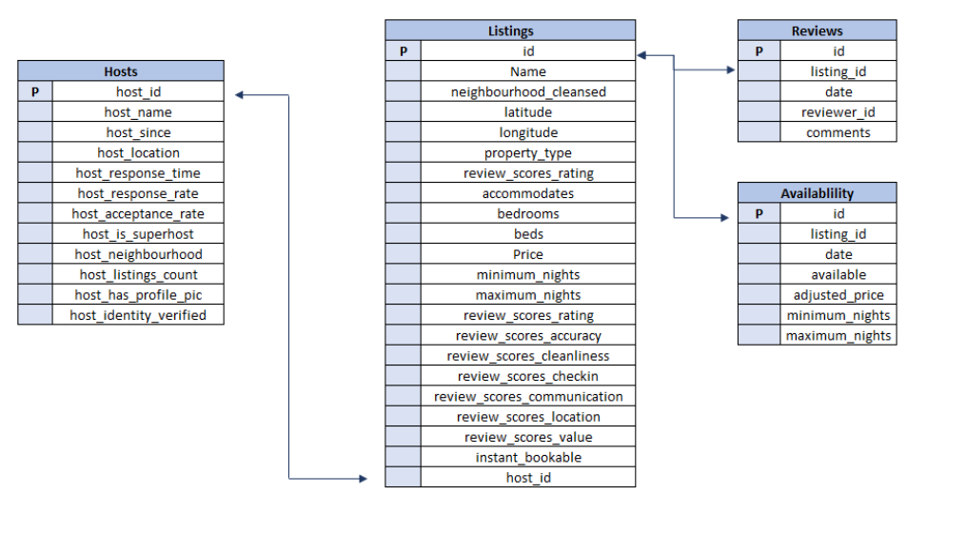
ABOUT DATA
METADATALink

Slide 5
ANALYSIS OF ACCEPTANCE & RESPONSE RATE
The Acceptance rate of the Host is less than the Super hosts. So Super Hosts are more likely to be accepted rather than normal hosts.
The Response rate of the Host is less than the Super hosts. So Super Hosts are more likely to be answered rather than normal hosts.

Slide 6
ANALYSIS OF MONTHLY BOOKINGS

Slide 7
ANALYSIS OF RATINGS

Slide 8
ANALYSIS OF LOCAL AND FOREIGN HOSTS
The Response rate for local hosts is slightly greater than the foreign hosts.
The Response rate for local hosts is slightly greater than the foreign hosts.

Slide 9
ANALYSIS OF TORONTO & VANCOUVER LISTINGS SALES
1 | The Response rate of Toronto’s Super host is greater than the response rate of Vancouver’s Super host.
2 | The Acceptance rate of Toronto’s Super host is smaller than the response rate of Vancouver’s Super host.
3 | The Average review scores of Toronto's Super host are better than that of Vancouver's Super host.
4 | The percentage of Toronto’s Super host whose Identity has not verified are greater than the Vancouver's Super host.
5 | The average bookings of Vancouver's hosts is 126% percent higher than the average bookings of Toronto's.
6 | The price for listings of local hosts will be decreasing in the upcoming year both the cities.
7 | The price for listings of Foreign hosts will be increasing in the upcoming year both the cities.
8 | The no of hosts is in Toronto city as compared to Vancouver.
9 | The percentage of Vancouver's super host is more than Toronto's super host.

Slide 10
CONCLUSION
The three most critical factors to being a SuperHost:
1. Acceptance Rate
2. Response Rate
3. Reviews

Slide 11
REFERENCES
Project Link https://drive.google.com/drive/folders/1zXzvhxK4EIwlPi86ZoRfBoLS_mFzM9Du?usp=sharing

Slide 12
QUESTIONS?

Slide 13
THANK YOU !!!

